Slide 1

8th Grade Math: Pre-Algebra
Unit 13, Lesson 7 Finding Missing Angles in Polygons Volume 2, pg. 300

Slide 2


Benchmark
MA.8.GR.1.6
Develop and use formulas for the sums of the interior angles of regular polygons by decomposing them into triangles.
volume 2, pg. 300

Slide 3
Integrated Mathematical Thinking and Reasoning Standards
MA.K12.MTR.1.1 Actively participate in effortful learning both individually and collectively.
MA.K12.MTR.3.1 Complete tasks with mathematical fluency.
MA.K12.MTR.5.1 Use patterns and structure to help understand and connect mathematical concepts.
volume 2, pg. 300

Slide 4


Learning Target
I can write and solve algebraic equations to find the measure of an interior angle of a $n$-gon.
volume 2, pg. 300

Slide 5

Warm-Up
volume 2, pg. 301

Slide 6
13.7.1 Warm-Up: Fighting Fire With Math
Cassie Pennicuik fights fire with math. As a program manager at the County Fire Authority, her job is to lead the growth program. Part of her job is to create a bridge between the technical, strategic, and tactical teams in the organization. She says, “If you really want something in life, go for it and celebrate the effort. In the end, hard work definitely pays off.”
What do you think she means by “celebrate the effort”?
Describe a time you went for something that didn’t work out, but you still celebrated the effort.
volume 2, pg. 301

Slide 7

Guided Instruction
volume 2, pg. 301

Slide 8
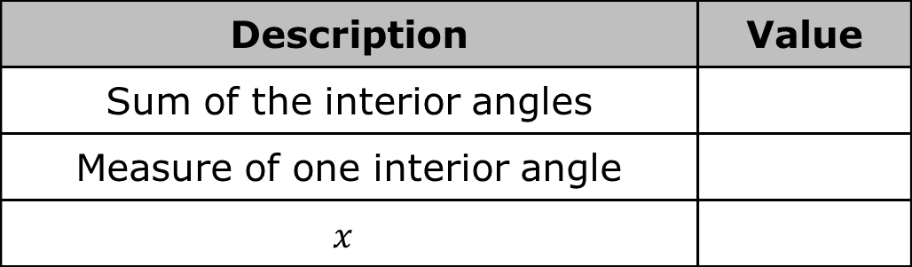
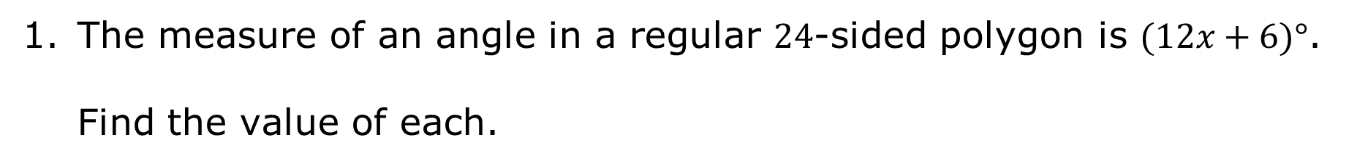
13.7.2 Guided Instruction: Measures of Interior Angles Using Equations
The measure of an angle in a regular $24$-sided polygon is $(12x+6)°$.
Find the value of each.
Description | Value
Sum of the interior angles
Measure of one interior angle
$$x$$
volume 2, pg. 301

Slide 9
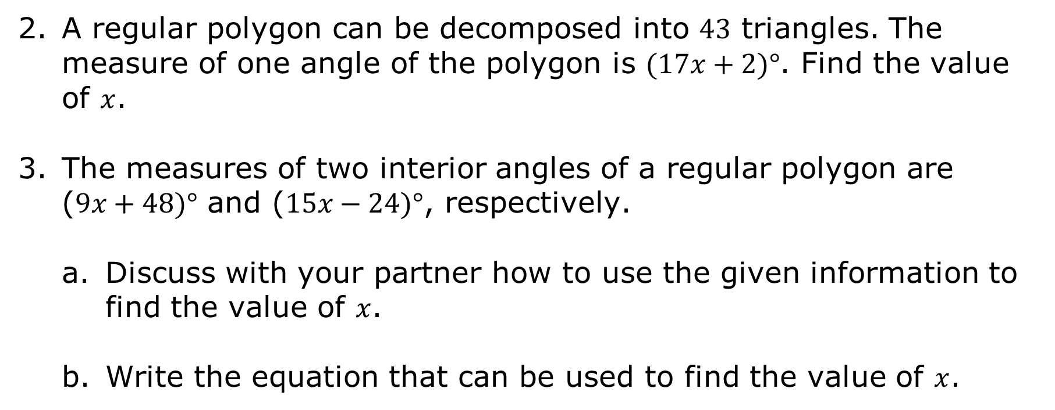
A regular polygon can be decomposed into $43$ triangles. The measure of one angle of the polygon is $(17x+2)°$. Find the value of $x$.
The measures of two interior angles of a regular polygon are ($9x+48)°$ and ($15x−24)°$, respectively.
Discuss with your partner how to use the given information to find the value of $x$.
Write the equation that can be used to find the value of $x$.
volume 2, pg. 301

Slide 10
Solve the equation.
What is the angle measure for each interior angle in the polygon?
volume 2, pg. 302

Slide 11

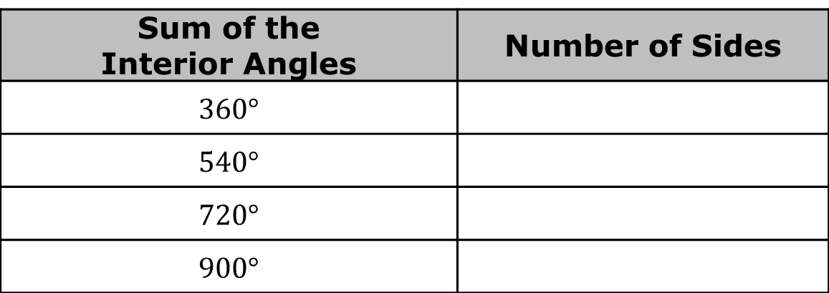
Discuss with your partner how to determine the number of sides that a regular polygon has if the sum of the interior angles is given.
Work with your partner to complete the table.
How many sides does a regular polygon have if the sum of the interior angles is $6,300°$?
Sum of the Interior Angles | Number of Sides
$$360°$$
$$540°$$
$$720°$$
$$900°$$
volume 2, pg. 302

Slide 12
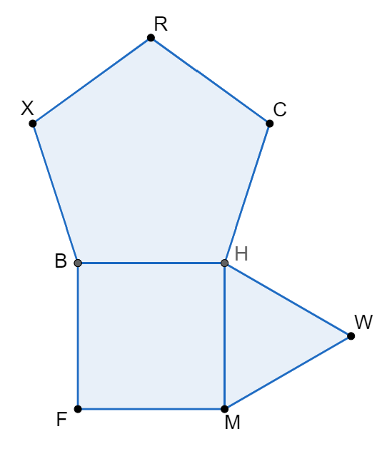

Regular polygons $XRCHB$, $BHMF$, and $HWM$ are shown.
The measure of angle $WHC$ is $(19x−27)°$. Determine the value of $x$.
volume 2, pg. 302

Slide 13

Guided Practice
volume 2, pg. 303

Slide 14

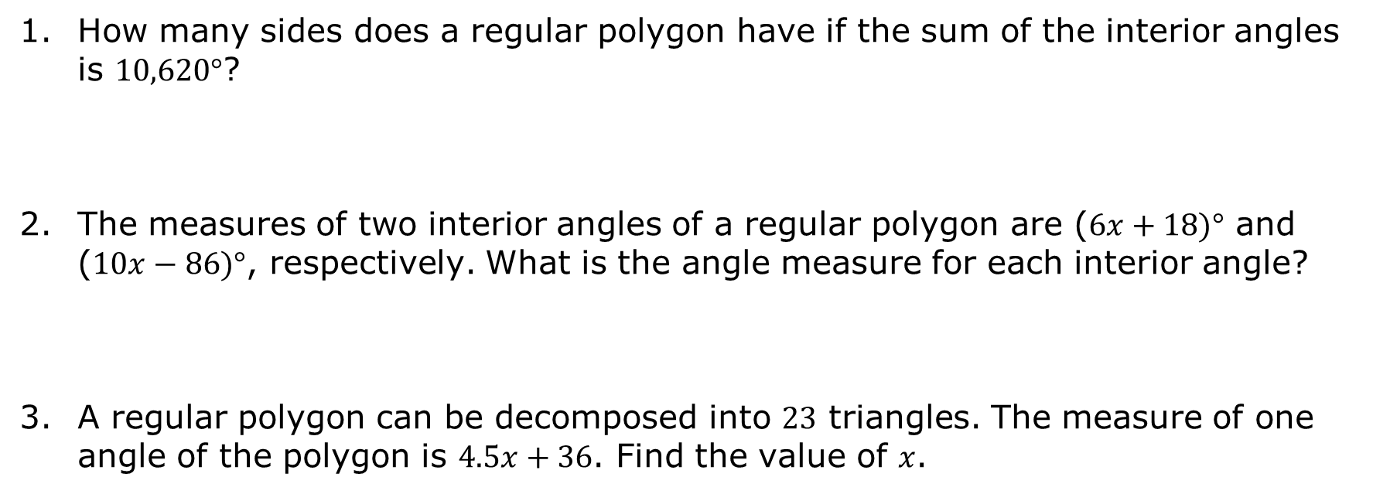
13.7.3 Guided Practice: Measures of Interior Angles Using Equations
How many sides does a regular polygon have if the sum of the interior angles is $10,620°$?
The measures of two interior angles of a regular polygon are ($6x+18)°$ and ($10x−86)°$, respectively. What is the angle measure for each interior angle?
A regular polygon can be decomposed into $23$ triangles. The measure of one angle of the polygon is $4.5x+36$. Find the value of $x$.
volume 2, pg. 303

Slide 15

Your Turn
volume 2, pg. 303

Slide 16
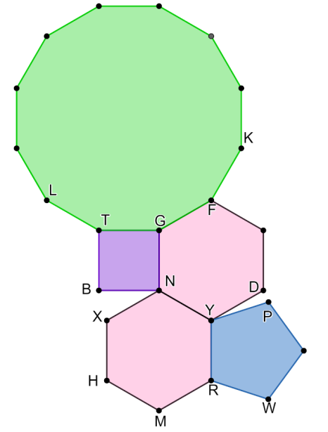
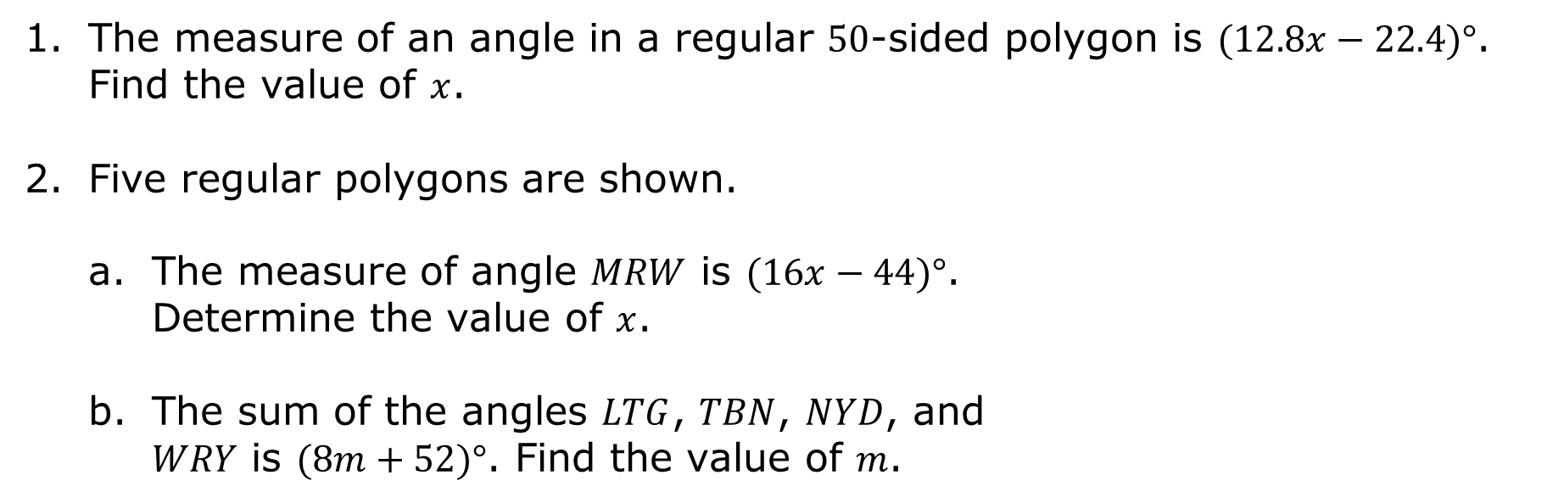
13.7.4 Your Turn!
The measure of an angle in a regular $50$-sided polygon is $(12.8x−22.4)°$. Find the value of $x$.
Five regular polygons are shown.
The measure of angle $MRW$ is $(16x−44)°$. Determine the value of $x$.
The sum of the angles $LTG$, $TBN$, $NYD$, and $WRY$ is $(8m+52)°$. Find the value of $m$.
volume 2, pg. 303

Slide 17

Wrap-Up
volume 2, pg. 304

Slide 18

13.7.5 Wrap-Up: Reflection
Reflect on your learning today by completing each sentence. Write your response on each finger.
volume 2, pg. 304

